Slide 1
Branch Protection
Fumihiko Shiroyama

Slide 2
DEMO

Slide 3
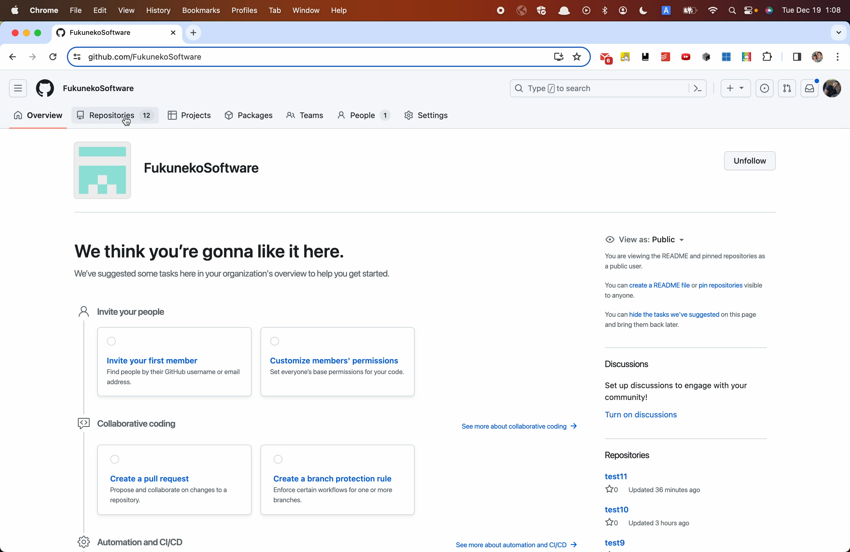

Slide 4
Considerations
Triggered by Repository events
Notifies Azure Functions
SSL Verification
Secret Signature
Payload is signed with a secret to prevent tampering

Slide 5








C
Network access control
② Webhooks
signature check
④ Secrets
⑤ Call GitHub APIs
① Create Repository
③ Authenticate

Slide 6

WebHOOK
Triggered by Repository events
Notifies Azure Functions
SSL Verification
Secret Signature
Payload is signed with a secret to prevent tampering

Slide 7
Azure Functions
Managed ID enabled and retrieves secret information from Key Vault safely
Detects tampering by calculating the signature of the body text and comparing it with the signature information in the header
Only allow access from the IP range of the GitHub Webhooks
API calls with PAT token safely obtained from Key Vault
Fine-grained personal access tokens that minimize risks

Slide 8
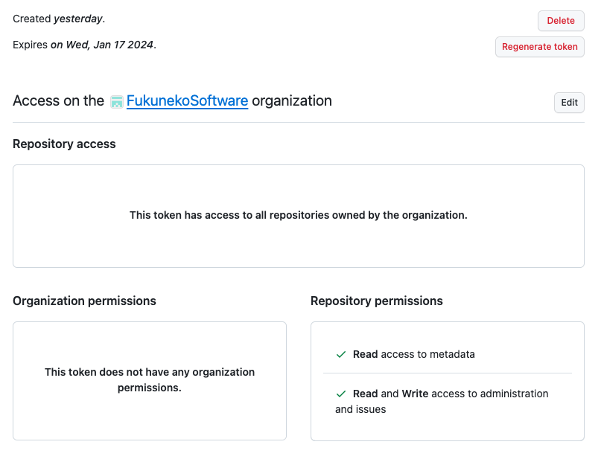
PAT TOKEN WITH LIMITED SCOPES

Slide 9
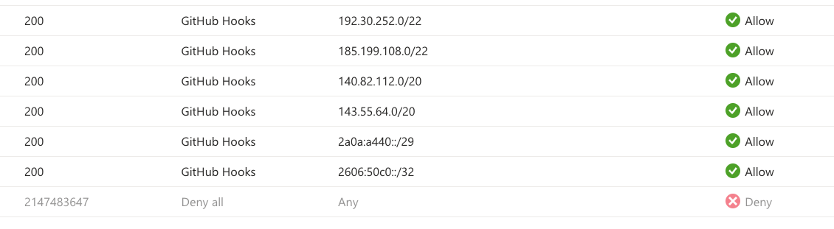
Access Control of Functions

Slide 10
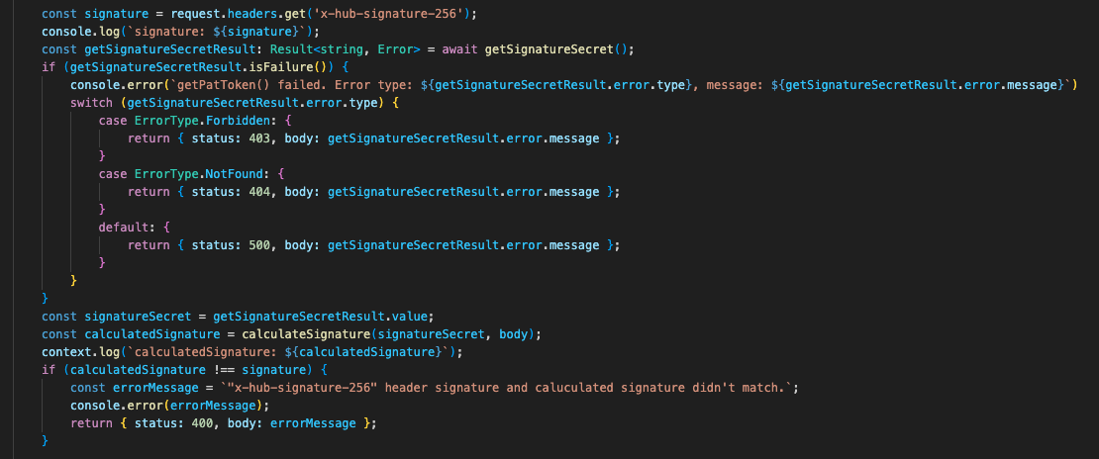
Signature checking

Slide 11
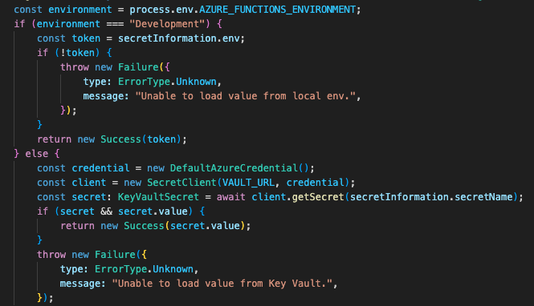
Key Vault for Secrets

